Slide 1
CSCIU 210 Computer Organization AKM Jahangir A Majumder, PhD
Fall 2018 - Lecture 20
October 15, 2018
Note: Some slides are adapted from those used by previous instructors and some slides include figures from the textbook.

Slide 2
Review and Learning Outcomes
We finished our coverage on how to do simple ALU design
Will cover:
Sequential Logic Circuit
S-R Latch
D- Latch
D Flip-Flop
We will have Quiz 4 on Wednesday, October 17, which will cover lecture 16-19
HW 4 is posted on Blackboard, which is due on Wednesday, October 17

Slide 3
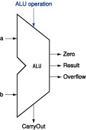
Review: Our 32-bit ALU Symbol
ALU control lines: 0000 = and 0001 = or 0010 = add 0110 = subtract 0111 = slt 1100 = NOR

Slide 4
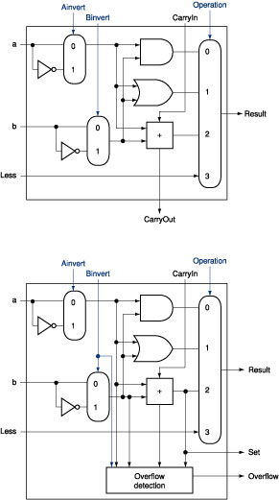
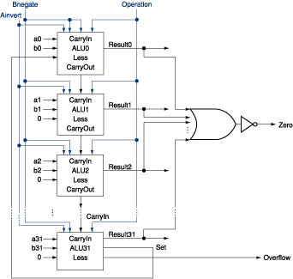
Review: The ALU Diagram
ALU control lines: 0000 = and 0001 = or 0010 = add 0110 = subtract 0111 = slt 1100 = NOR
ALU 0~30
ALU 31
Can this ALU implement a NAND function?

Slide 5
Sequential Logic Diagram
So far, we focus only on combinational logic system which does not have memory.
We will begin to cover sequential logic now.
We will need sequential logic to build registers in our MIPS computers.

Slide 6
Combinational Circuits
A combinational logic circuit has:
A set of m Boolean inputs,
A set of n Boolean outputs, and
n switching functions, each mapping the 2^{m} input combinations to an output such that the current output depends only on the current input values
A block diagram:
Combinatorial
Logic
Circuit
m Boolean Inputs
n Boolean Outputs

Slide 7
Introduction to Sequential Circuits
Inputs
Outputs
Combina-tional
Logic
A Sequential circuit contains:
Storage elements: Latches or Flip-Flops
Combinatorial Logic:
Implements a multiple-output switching function
Inputs are signals from the outside.
Outputs are signals to the outside.
Other inputs, State or Present State, are signals from storage elements.
The remaining outputs, Next State are inputs to storage elements.
Storage Elements
Next
State
State

Slide 8
Introduction to Sequential Circuits (Cont.)
Combinatorial Logic
Next state function Next State = f(Inputs, State)
Output function (Mealy) Outputs = g (Inputs, State), Mealy Model
Output function (Moore) Outputs = h (State), Moore Model
Output function type depends on specification and affects the design significantly
Inputs
Outputs
Combina-tional
Logic
Storage Elements
Next
State
State

Slide 9
Classification of Sequential Systems
Synchronous Sequential System: State updated at discrete time.
Asynchronous Sequential System: State updated at any time.

Slide 10
State Elements
Unclocked vs. Clocked
Clocks used in synchronous logic
when should an element that contains state be updated?
cycle time

Slide 11
Latches and Flip-flops
Output is equal to the stored value inside the element (DON’T need to ask for permission to look at the value)
Change of state (value) is based on the clock
Latches: whenever the inputs change, and the clock is asserted
Flip-flop: state changes only on a clock edge (edge-triggered methodology)
A clocking methodology defines when signals can be read and written — wouldn't want to read a signal at the same time it was being written
"logically true",
— could mean electrically low

Slide 12
Basic (NOR) S – R Latch
R (reset)
Cross-coupling two NOR gates gives the S – R Latch:
Which has the time sequence behavior:
Q
S (set)
Q
S
R
Q
Q
Comment
1
0
1
0
Set State
0
0
1
0
Set State
0
1
0
1
Reset State
0
0
0
1
Reset State
1
1
0
0
Undefined

Slide 13
R-S Latch: Set State
R (reset)
0
Q
0
1
Q[n-1]
0
Q
S (set)
1

Slide 14
R-S Latch:
R (reset)
0
Q [n-1]
Q
Q’[n-1]
Q[n-1]
Q’[n-1]
Q
S (set)
0

Slide 15
R-S Latch: Reset Stage
R (reset)
1
Q
Q’[n-1]
0
0
1
Q
S (set)
0

Slide 16
R-S Latch: Un-defined Stage
R (reset)
1
Q
Q’[n-1]
0
Q[n-1]
0
Q
S (set)
1

Slide 17
An Un-clocked State Element
The set-reset latch (S-R Latch)
output depends on present inputs and also on past inputs
S
R
Q
Q
Comment
1
0
1
0
Set State
0
0
1
0
Set State
0
1
0
1
Reset State
0
0
0
1
Reset State
1
1
0
0
Undefined

Slide 18
D Latch
Adding an inverter to the S-R Latch, gives the D Latch
Q
D
Q(t+1)
Comment
0
0
0
No change
0
1
1
Set Q
D
Q
1
0
0
Clear Q
1
1
1
No Change
C
Q

Slide 19
D Latch (Cont.)
Two inputs:
the data value to be stored (D)
the clock signal (C) indicating when to read & store D
Two outputs:
the value of the internal state (Q) and it's complement

Slide 20
The Latch Timing Problem
In a sequential circuit, paths may exist through combinational logic:
From one storage element to another
From a storage element back to the same storage element
The combinational logic between a latch output and a latch input may be as simple as an interconnect
For a clocked D-latch, the output Q depends on the input D whenever the clock input C has value 1

Slide 21
The Latch Timing Problem (continued)
Consider the following circuit:
Suppose that initially Y = 0.
As long as C = 1, the value of Y continues to change!
The changes are based on the delay present on the loop through the connection from Y back to Y.
This behavior is clearly unacceptable.
Desired behavior: Y changes only once per clock pulse
Y
D
Q
Clock
C
Q
Clock
Y

Slide 22
The Latch Timing Problem (continued)
A solution to the latch timing problem is to break the closed path from Y to Y within the storage element
The commonly-used, path-breaking solutions replace the clocked D-latch with:
a master-slave flip-flop
an edge-triggered flip-flop

